Slide 2
Nathan Davids
Okuhle Charlieman
Cole Hanekom
Kiran Isaacs
NOCK - NOCK
Who’s There???

Slide 3
Content
01
Introduction
02
Problem
03
Solution
04
Gantt Chart
05
Website

Slide 4
Introduction
01
HTML
02
CSS
- Hypertext Markup Language.
- used to create websites.
- Cascading Style Sheets.
- Assists markup languages through styling.
Mzamomtsha Primary school
Government Support
03
Bootstrap
04
05
- Open source framework
- provides a collection of syntax for template designs. That are responsive.
- informal settlement > township.
- state of the art housing.
- government support.
- Between Khayelitsha and Umfuleni.
- Driftsands informal settlement.

Slide 5
Problem(s)
1
3
Initial grades ranged from 1 to 7
The school has no online presence
2
4
Lack of Infrastructure
Insufficient staff members

Slide 6
Solution
1
Due to the rapid population growth the school is enrolling higher grades
Adding grades 8 - 12
SOLUTION
Design a website that will provide Mzamomtsha with facilities to do this
2
Try to get donations and sponsorships. This will help the school improve and expand on the current infrastructure

Slide 7
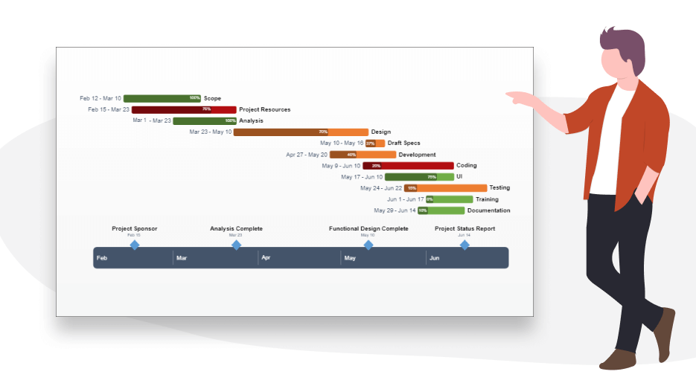
GANTT CHART
.

Slide 8
Mzamomtsha Primary School

Slide 9

Thank You
Any question???

